Slide 1

CHAPTER 1:
MANAGEMENT AND ORGANIZATION

Slide 2
LEARNING OUTCOMES
Explain key concepts in management
Distinguish roles and functions of manager in an organization
Distinguish managerial levels
Explain keys managerial skills

Slide 3
CONTENTS
  Some Basic Concepts
  Roles of a manager in an organization
  Basic functions of a manager in an organization
  Management levels
  Necessary Skills of a manager

Slide 4
1.1 SOME BASIC CONCEPTS

Slide 5
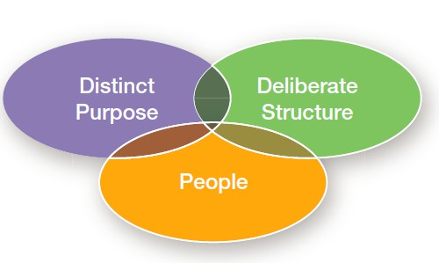
What is Organization?
Organization – A deliberate arrangement of people assembled to accomplish some specific purpose (that individuals independently could not accomplish alone).
Common characteristics of Organizations:
Have a distinct purpose (goal)
Are composed of people
Have a deliberate structure
5

Slide 6
What is Organization?
- Name an organization you like?
6

Slide 7












What is Enterprise?
Input
Process
Output
- Distinguish Enterprise vs. Organization?
7

Slide 8

Who is manager?
Manager - Someone who coordinates and oversees the work of other people so organizational goals can be accomplished
8

Slide 9
What is management?
Management involves coordinating and overseeing the work activities of others so that their activities are completed efficiently and effectively.
Efficiency Effectiveness
Doing the right things
Doing those work activities that will result in achieving goals
Doing things right
Getting the most output from the
least inputs
Which one is more important?
9

Slide 10
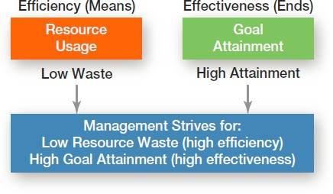
Efficiency and Effectiveness
Time for watching!!!!!!
10

Slide 11
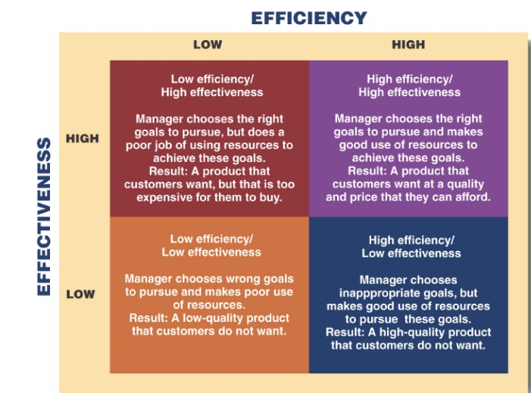
Efficiency and Effectiveness
11

Slide 12
1.2 ROLES OF A MANAGER IN AN ORGANIZATION

Slide 13
Three types of roles
According Mintzerg et al (1973):
Interpersonal roles
  Figurehead, leader, liaison
Informational roles
  Monitor, disseminator, spokesperson
Decisional roles
  Entrepreneur, disturbance handler, resource allocator, negotiator

Slide 14
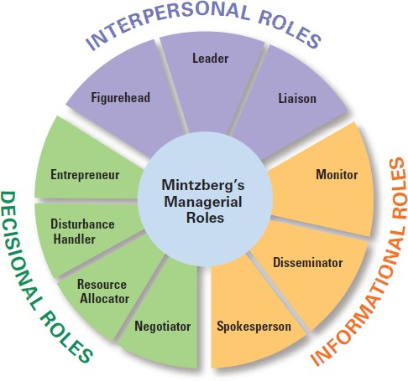
Three types of roles
Mintzberg’s Managerial Roles
Source: Mintzberg, The nature of managerial work (1983)

Slide 15
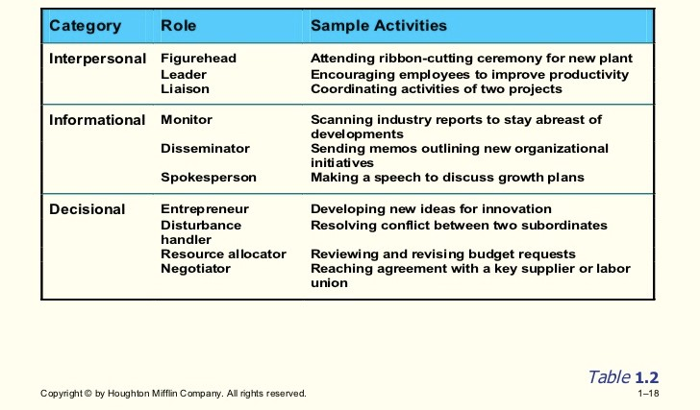

Three types of roles

Slide 16
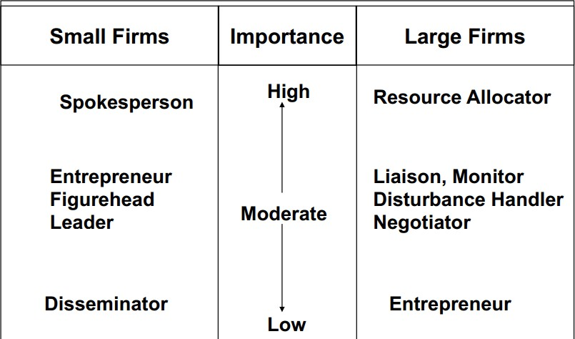
The role that Manager play

Slide 17
1.3 BASIC FUNCTIONS OF A MANAGER IN AN ORGANIZATION

Slide 18
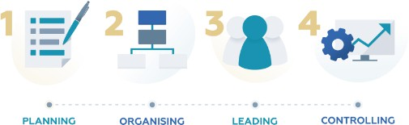
Four functions of management
Planning – Defining goals, establishing strategies to achieve goals, and developing plans to integrate and coordinate activities
Organizing – Arranging and structuring work to accomplish organizational goals.
Leading – Working with and through people to accomplish goals.
Controlling – Monitoring, comparing, and correcting work.

Slide 19
Why are managers important?
Inspire you professionally and personally
Energize you and your coworkers to accomplish things together that you couldn’t get done by yourself
Provide coaching and guidance with problems
Provide you feedback on how you’re doing
Help you to improve your performance
Keep you informed of organizational changes
Change your life

Slide 20
1.4 MANAGEMENT LEVELS

Slide 21
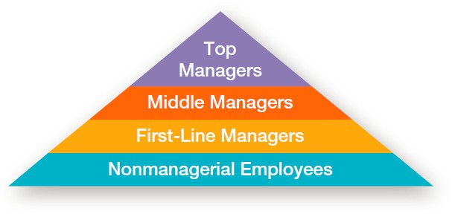
Level of management
Top Managers - Individuals who are responsible for making organization-wide decisions and establishing plans and goals that affect the entire organization.
Middle Managers - Individuals who manage the work of first-line managers.
First-line Managers - Individuals who manage the work of non- managerial employees.

Slide 22
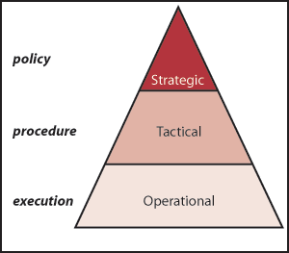
Level of management
Strategic managers
Tactical managers
Operational managers

Slide 23
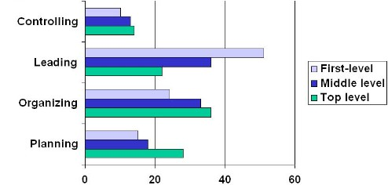
Time managers spend on different functions at different levels
Source: Robbins et al., Fundamentals of management (2005)

Slide 24
1.4 NECESSARY SKILLS OF A MANAGER

Slide 25
Three main skills managers need
Technical skills
  Knowledge and proficiency in a specific field
Human skills
  The ability to work well with other people
Conceptual skills
  The ability to think and conceptualize about abstract and complex situations concerning the organization

Slide 26
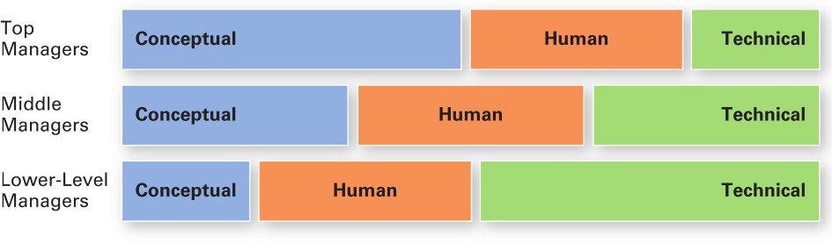
Skills needed at different managerial levels

Slide 27
Managers with the Fast-Changing World?
Management is no longer constrained by national borders
Managers need to understand what is going on in the world
Managers need to take into consideration different economic, political, legal and cultural systems in other countries

Slide 28

29

